Slide 1
Europe in the Middle Ages
EHAP

Slide 2
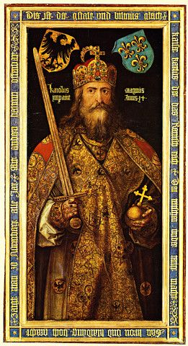
Quest for Political Order
Fall of roman Empire
Germanic Successors
The Franks
External invasions
Emperor Charlemagne

Slide 3
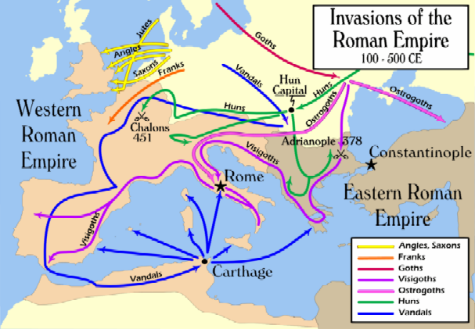
Fall of the Western Roman Empire

Slide 4
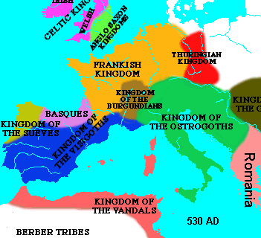
Germanic Successor States
Decentralized Society
  German chieftains replace Roman rule
  Germanic tradition replaced Roman law
  Peasants turn to local lords for safety
Subsistence Agriculture
Power shifts from Italy to France

Slide 5
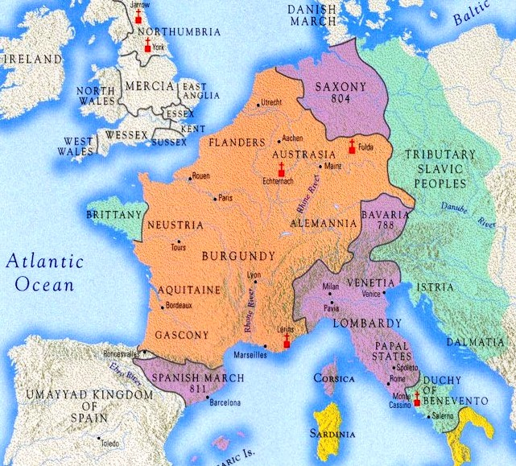
The Franks
Clovis I (466-511)
  United the Franks
  Converted to Christianity
Charles Martel (688-741)
  Defeated Muslim at Tours
Charlemagne (742-814)
  Centralized authority
  Temporary revival of learning
  Empire fell less than 30 years after his death
Battle of Tours, 732

Slide 6
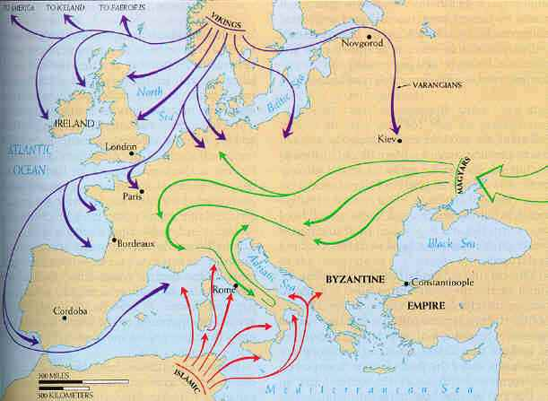
External Invasions
External invasions by Vikings (purple), Magyars (green), and Muslims (red) completed the destruction of centralized rule in Western Europe.
European lords built a system of military and political relationships to protect their land. This system is called feudalism.

Slide 7
Medieval Society (600-1000)
Feudalism
Serfs and manors
The medieval Christian Church

Slide 8
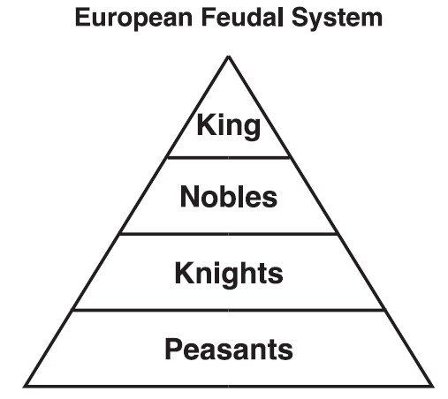
European Feudalism
Kings and nobles gave land (fief ) to vassals (nobles) in exchange for military service
  Control of land was hereditary
Vassals gave land to knights in exchange for military service
  Knights were bound by a code of chivalry

Slide 9
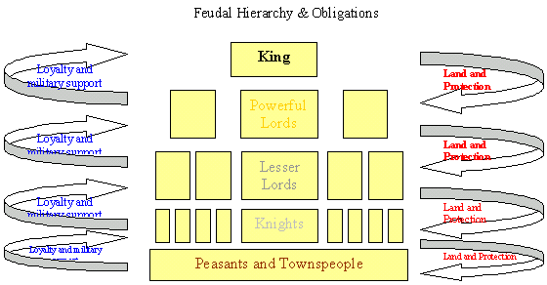
European Feudalism

Slide 10
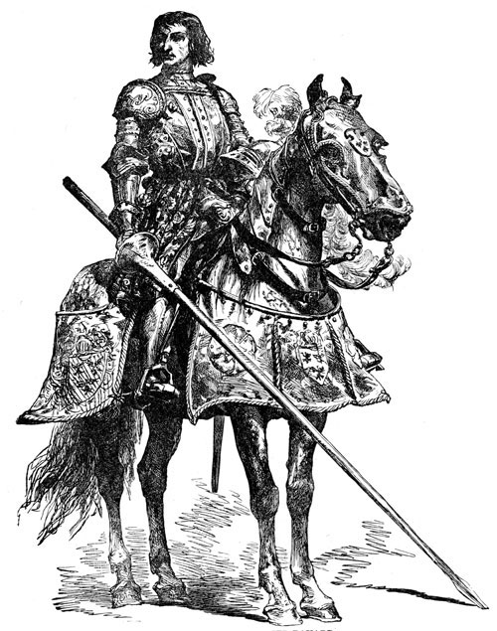
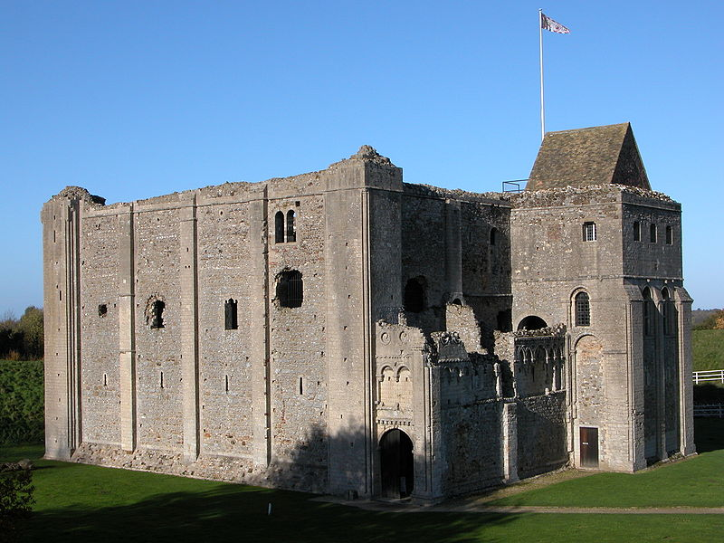
Knights and Castles
The Knight
The Castle
Castle Rising in England was built in 1138

Slide 11
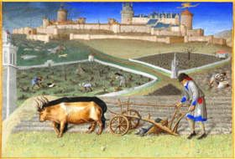
Serfs and Manorialism
Agricultural manors were essential for maintaining the feudal system
  Manors included a mill, church, workshops, and a village
Serfdom
  Bound to the land
  Cultivated land for lords in exchange for protection and a small plot of land
  Also were responsible for weaving, building, etc.
Serfs were required to work their lords land three days a week. The rest of the time they could work the small plots of land provided to them by their lord.

Slide 12
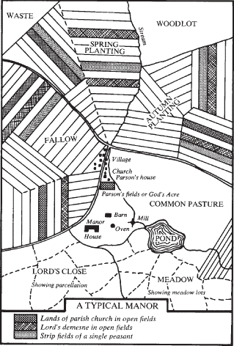
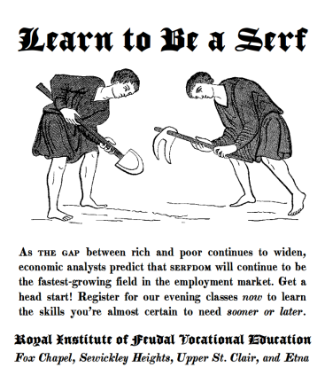
Manorialism

Slide 13
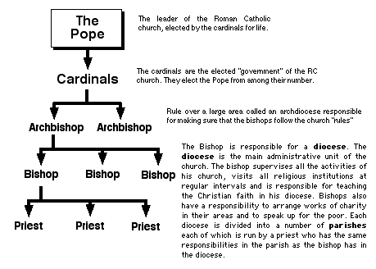
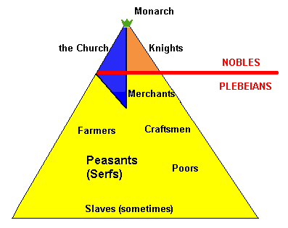
The Christian Church
Created moral standards
Owned extensive land throughout Western Europe
Struggled with secular rulers to be the dominant authority in Europe
Supported monasticism
  Monks preserved literacy and learning
  Nuns provided an additional opportunity for women

Slide 14
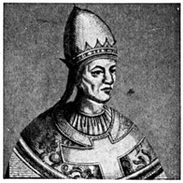
The Pope
Papal authority grew during early medieval period
  Canon law
  Excommunication
  Investiture
Frequent power struggles between monarchs and the papacy
  Henry IV and Gregory VII
A symbol of papal authority, Pope Gregory VII declared the church infallible and capable of removing emperors

Slide 15
Expansion of Europe
Vikings
Spanish Reconquista
The Crusades

Slide 16
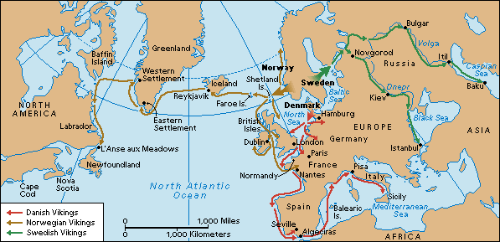
Viking Expansion

Slide 17
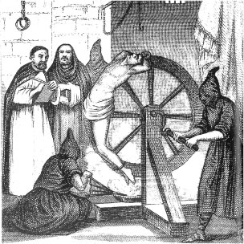
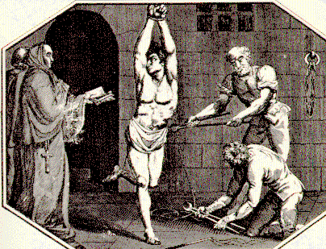
Spanish Reconquista
Began in small Christian states in northern Spain
By 1150 Christians had recaptured over half of Muslim Spain
  Aided by organization and wealth of Catholic Church
Ended in 1492 with conquest of Granada
  Drove Jews and Muslims from Spain
The Spanish Inquisition

Slide 18
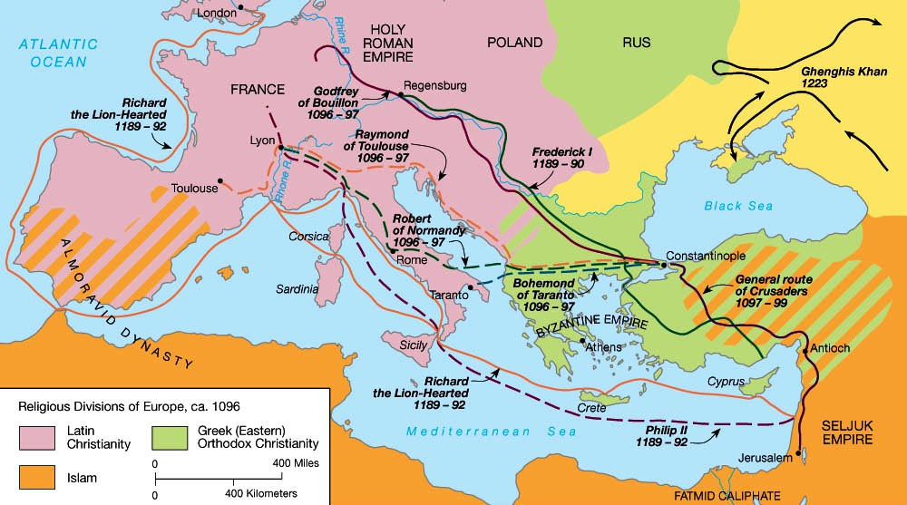
The Crusades

Slide 19
High Middle Ages (1000-1500)
Establishment of regional states
European Economic Revival
social developments
Christianity during the high middle ages

Slide 20
Rise of Regional States
Holy Roman Empire (Germany)
  “neither holy, nor Roman, nor an empire”
  Conflicts with church prevented creation of a powerful state
France
  Capetian dynasty consolidated feudal estates into a centralized government
    Feudal monarchy
Italy
  Dominated by powerful city-states: Rome (papal state), Florence, Genoa, Milan, Venice, etc.

Slide 21
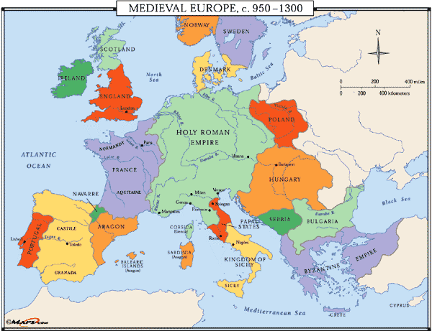
Europe in the High Middle Ages

Slide 22
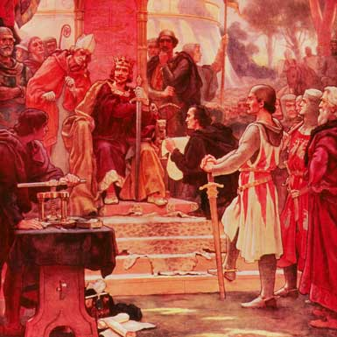
Rise of Monarchy in England
William of Normandy conquered England in 1066
  Feudalism with centralized approach
Magna Carta signed by King John in 1215
  Created parliamentary system
  Parliament must approve changes in taxation
  Does NOT create a democratic system
King John, enemy of Robin Hood, was forced to sign the Magna Carta in 1215

Slide 23
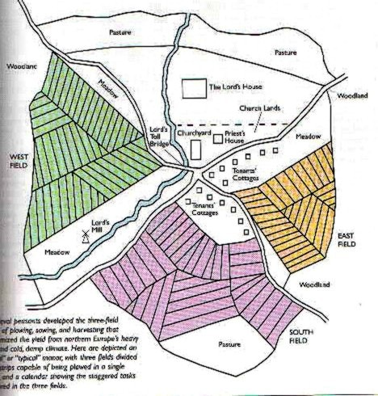
European Economic Revival
Changing Agricultural Economy
  Technology: improved plows, watermills, the horse collar, and the horseshoe
  Crop rotation and the three-field system
  Population growth
    800 CE—29 Million
    1100 CE—44 Million
    1300 CE—79 Million
Population growth led to urbanization
  London, Paris, Toledo, etc.
  Some towns challenged the authority of their feudal lord

Slide 24
European Economic Revival
Urbanization increased specialization of labor
  Guilds created regulations between craftsmen
    Protect prices, regulate production, etc.
Specialized labor increased manufacturing
  Manufacturing focused on wool textiles
  Woolen textiles dominated by Italy and Flanders (Belgium)
Increased manufacturing led to increased trade
  Italian merchants dominated trade in the Mediterranean
  Increased involvement in the Afro-Eurasian trade network
    Silk Roads, Trans-Saharan, etc.
  Hanseatic League promotes trade in northern Europe

Slide 25
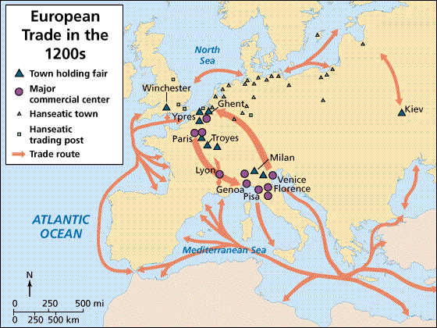
Trade in the High Middle Ages
Venetian and Genoese merchants established colonies in major trade ports of Alexandria, Constantinople, Cairo, Damascus, etc.

Slide 26
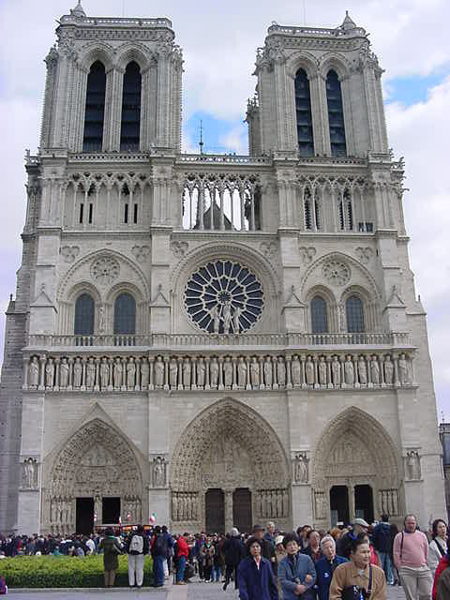
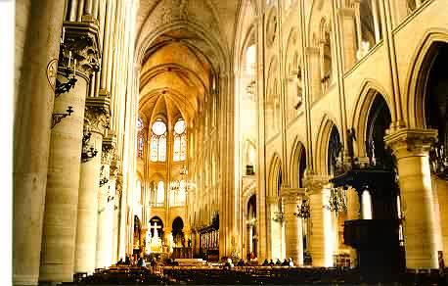
Social Developments
Status of women improved
  Chivalry promoted respect for women
  Urbanization created more job opportunities for women
    All-female guilds
  Worked same jobs as their husbands
  Increased veneration of the Virgin Mary
    Mary symbolized ideals of womanhood, love, & sympathy
Cathedral of Notre Dame or “Our Lady”

Slide 27
Christianity in the High Middle Ages
Cathedral schools become universities
  University of Paris, Oxford University, etc.
Rediscovery of works of Aristotle
  Increased commerce with Muslims provided the West with access to Greek works
New intellectual movements
  Thomas Aquinas and scholasticism
    Combining Aristotle’s logic with Christianity to create the most truthful system of thought possible
Some reformers within in the church were worried about the materialism of the church

Slide 28
End of the Middle Ages
Bubonic Plague
Hundred Years War
The Italian Renaissance

Slide 29
Bubonic Plague
Silk Roads spread bubonic plague across Eurasia in the 14th century
In October 1347 a ship from the Crimea sailed into Messina. The crew had a "sickness clinging to their very bones.“
Rats carrying fleas got on shore spreading disease
  Increased trade helped spread the plague
  Close proximity, unsanitary conditions facilitated the spread into cities
25 million people died in the next several years, 1/4 to 1/3 of the population of Europe
  Population rebounded within 200 years

Slide 30
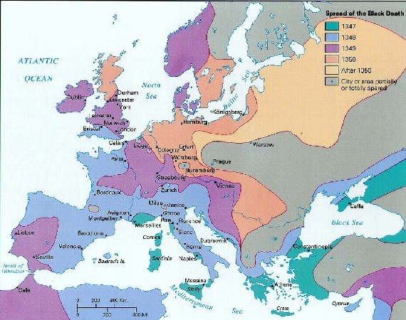
Spread of Bubonic Plague

Slide 31
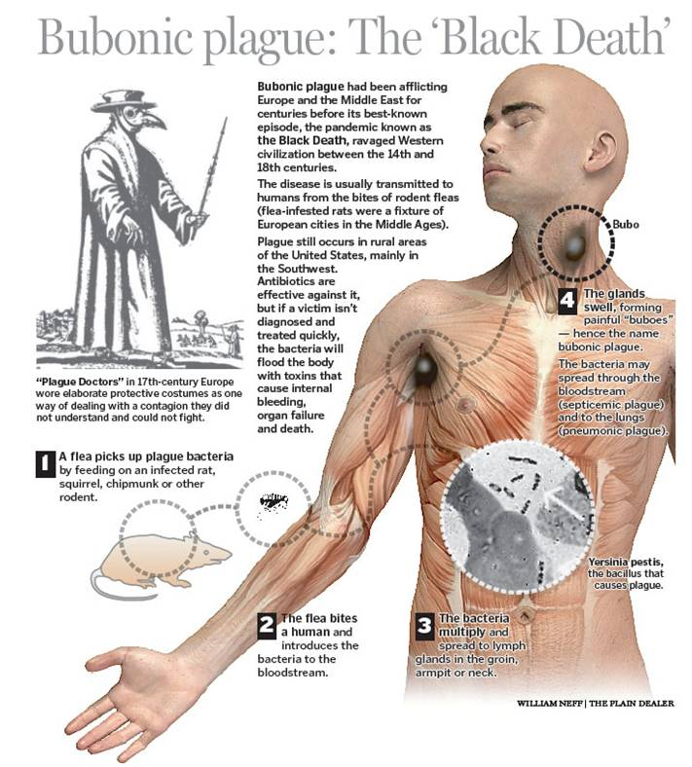
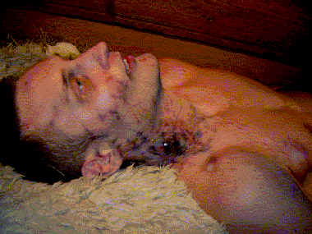
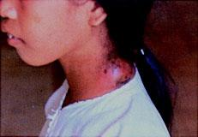
The Black Death
Victims “ate lunch with their friends and dinner with their ancestors in paradise”
-Geovanni Boccaccio

Slide 32
Impact of the Bubonic Plague
Profound impact on manorial economy
  Labor became scarce in some places
  Tenants, rent payers, made gains as feudal obligations were lowered
  Some serfs were freed to keep them from running away to better opportunities
  Wages rose in towns to keep workers happy
“The path to the Industrial Revolution began with the Black Death. The population fall increased labor mobility by creating many vacant farms, and that mobility undermined serfdom.” - Robert Allen

Slide 33
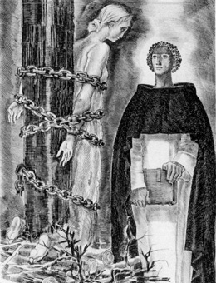
Hundred Years War (1337-1453)
A series of periodic military campaigns between England and France
New technology
  Crossbows, longbows, pikes, firearms, and cannons
    Castles & knights outdated
Monarchs maintain permanent militaries
Burning of Joan of Arc, 1431

Slide 34
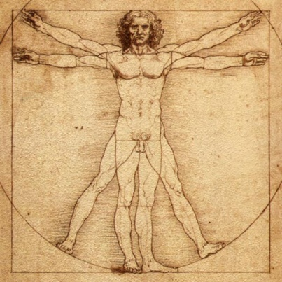
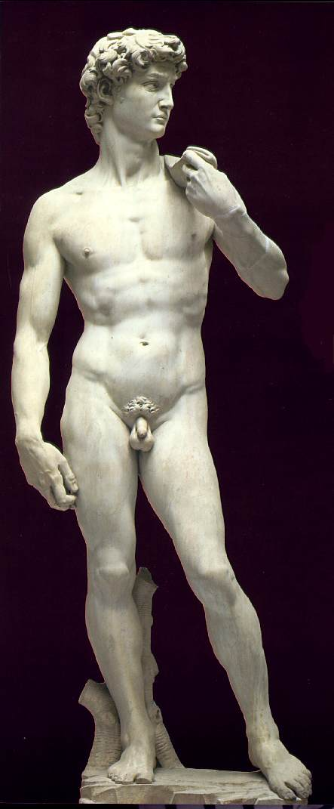
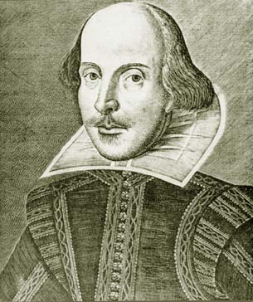
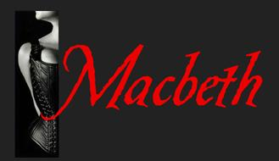
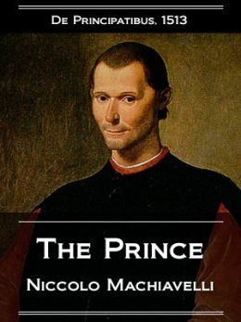
Italian Renaissance
Started in Italy during the 13th century
  Why Italy?
    Urban Growth & Wealth
    Merchant Class Values
    Classical Heritage
Main Idea: humanism
  Study of human beings and human potential
    Celebration of human life
  Many different approaches to humanism
It is better to be feared than loved, if you cannot be both.

